Slide 1
Smart Street Parking Assistant
Si-Qing Chen, Rui Hu, Sihong Liu,
Tomasz Religa, Jack Yong Wang, Ran Zhang

Slide 2
Problem & Solution
Problem
Searching for parking space is responsible for up to 40% of the total city traffic [1]
Cost in drivers’ time and fuel consumption
Result in city air pollution
Solution
Build a smart parking assistant.
Given a desired destination and arrival time, it will return street parking stations that have the highest probability of having available spaces.

Slide 3
Data Sets
Three publicly available data sets from Seattle Data Portal
Annual Parking Study Data (95.2K rows, 24 columns)
Road weather information station (27.2M rows, 6 columns)
SDOT_PayStations (1.7K rows, 29 columns)

Slide 4
Feature Engineering
Key features were identified based on literature review
Total Parking Spaces
Hourly Rate (obtained from SDOT_PayStations )
Weekday
time of the day
Location
Temperature(obtained from Road weather information station )

Slide 5
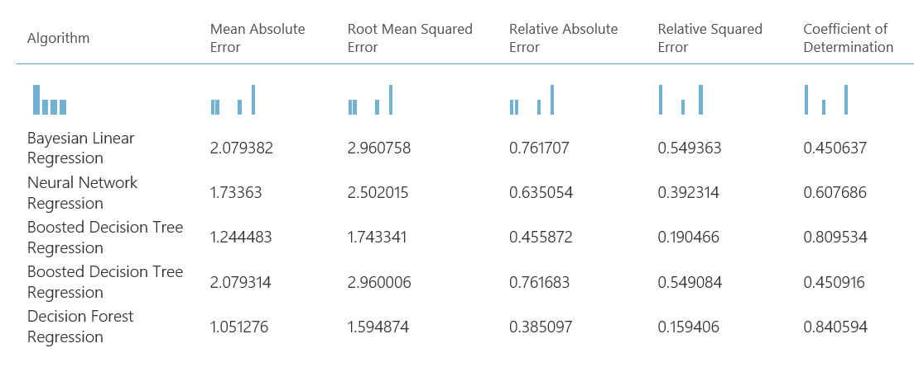

Model Comparison using Azure ML
Final choice: XGBoost

Slide 6
Real World Application
User Input
Address
Find nearby Pay station
Convert address to coordinates
Model Ranking
Predict available spots for nearby stations
Arrival Date Time
Locate top nearby pay stations
Give recommendations!
Application
Standalone mobile app
Integrated into car navigation system

Slide 7
Reference
[1] Giuffre, T., Siniscalchi, S. M., & Tesoriere, G. (2012). A Novel Architecture of Parking Management for Smart Cities. Procedia - Social and Behavioral Sciences, 53, 16-28.
[2] Heinrich C. Mayr, Martin , Pinzger(Hrsg.). Predicting the Availability of Parking Spaces with Publicly Available Data. INFORMATIK 2016.

